Slide 1
JULIUS ROBERT OPPENHEIMER
Em Artem
Alexey Kuznetsov
Maxim Zhemerikin

Slide 2
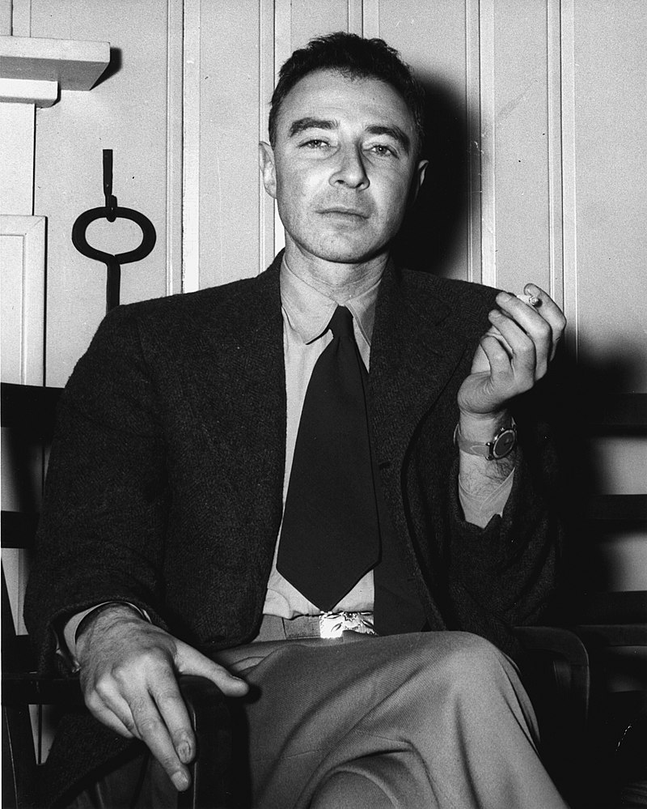
BIOGRAPHY
Oppenheimer served as the director of the Los Alamos Laboratory during World War II, and is often credited as the "father of the atomic bomb" for his role in the Manhattan Project, the research and development undertaking that created the world's first-ever nuclear weapons.
Oppenheimer attended Harvard University, where he earned a bachelor's degree in chemistry in 1925, and went on to study physics at the University of Cambridge and University of Göttingen, where he received his PhD in 1927. After completing his education, he held academic positions at the University of California, Berkeley, and the California Institute of Technology (Caltech), and made significant contributions to theoretical physics, including in quantum mechanics and nuclear physics.
Oppenheimer in 1946
with his trademark cigarette

Slide 3
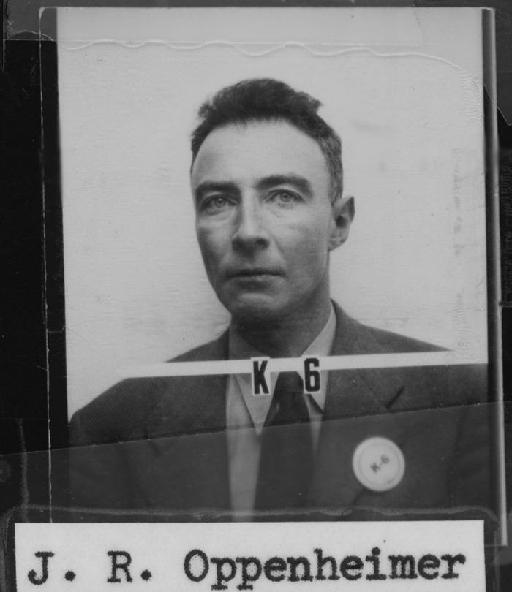
ACHIEVEMENTS
Oppenheimer's achievements in physics include the Born–Oppenheimer approximation for molecular wave functions, work on the theory of electrons and positrons, the Oppenheimer–Phillips process in nuclear fusion, and the first prediction of quantum tunneling. With his students he also made important contributions to the modern theory of neutron stars and black holes, as well as to quantum mechanics, quantum field theory, and the interactions of cosmic rays. As a teacher and promoter of science, he is remembered as a founding father of the American school of theoretical physics that gained world prominence in the 1930s.
Oppenheimer's ID badge
from the Los Alamos Laboratory

Slide 4

MANHATTAN PROJECT

Slide 5
“I am become Death, the destroyer of worlds.”
J. Robert Oppenheimer speaks those famous words. This video was posted on the 66th anniversary of the atomic bombing of Hiroshima.
https://www.youtube.com/watch?v=lb13ynu3Iac

Slide 6
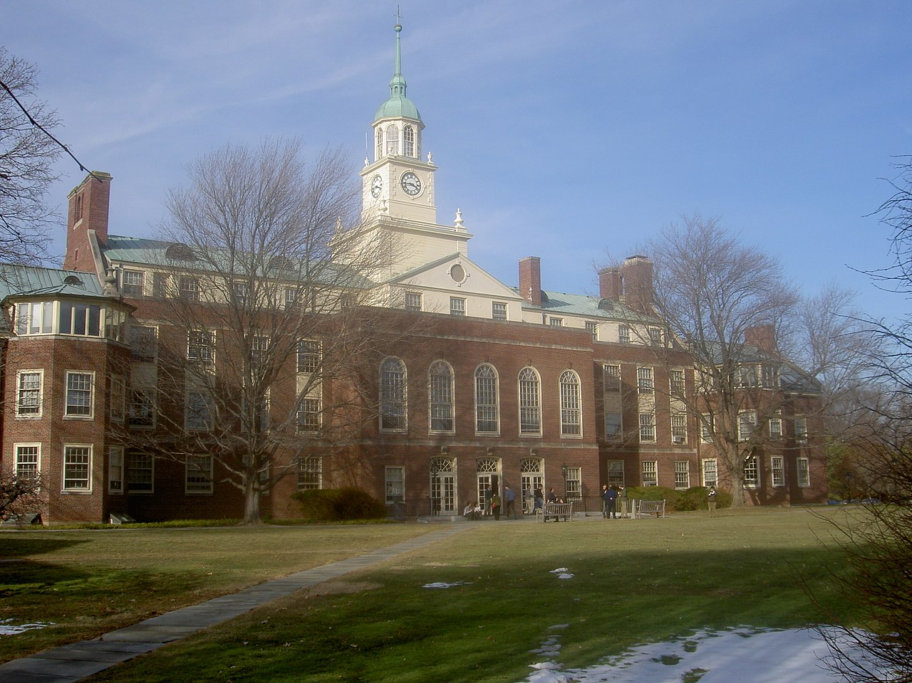
POSTWAR ACTIVITIES
In 1947, he accepted an offer from Lewis Strauss to take up the directorship of the Institute for Advanced Study in Princeton, New Jersey.
Oppenheimer brought together intellectuals at the height of their powers and from a variety of disciplines to answer the most pertinent questions of the age. He directed and encouraged the research of many well-known scientists, including Freeman Dyson, and the duo of Chen Ning Yang and Tsung-Dao Lee, who won a Nobel Prize for their discovery of parity non-conservation.
Institute for Advanced Study
in Princeton, New Jersey

Slide 7
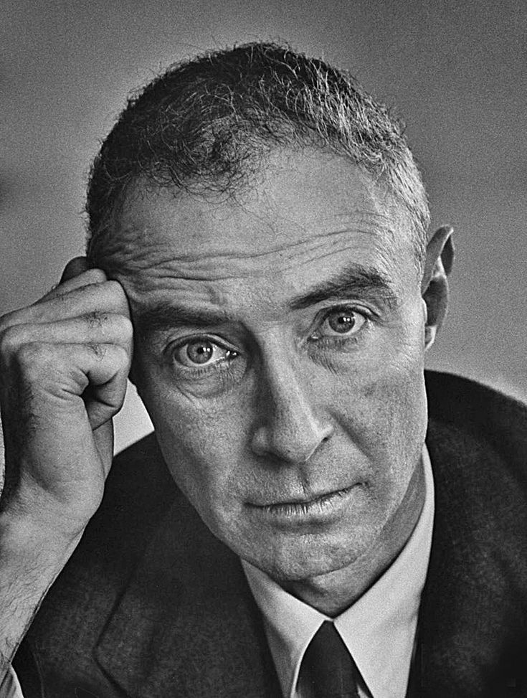
CONCLUTION
The Manhattan Project was top secret and did not become public knowledge until after the bombings of Hiroshima and Nagasaki, and Oppenheimer became a national spokesman for science who was emblematic of a new type of technocratic power. He became a household name and his portrait appeared on the covers of Life and Time. Nuclear physics became a powerful force as all governments of the world began to realize the strategic and political power that came with nuclear weapons. Like many scientists of his generation, he felt that security from atomic bombs would come only from a transnational organization such as the United Nations, which could institute a program to stifle a nuclear arms race.

Slide 8
THANKS FOR YOUR ATTENTION

